Slide 1

House Price Prediction
MLG Hackathon
28th May 2019
Kate Feng
Mehran Ghandehari

Slide 2
Machine Learning
A branch of artificial intelligence that based on the use of algorithms to give computer the ability to learn from data and make predictions on data.

Slide 3
Steps
1.Data collection
2.Data exploration
3.Data formatting
4.Feature engineering
5.Feature selection
6.Training
7.Prediction
8.Evaluation

Slide 4


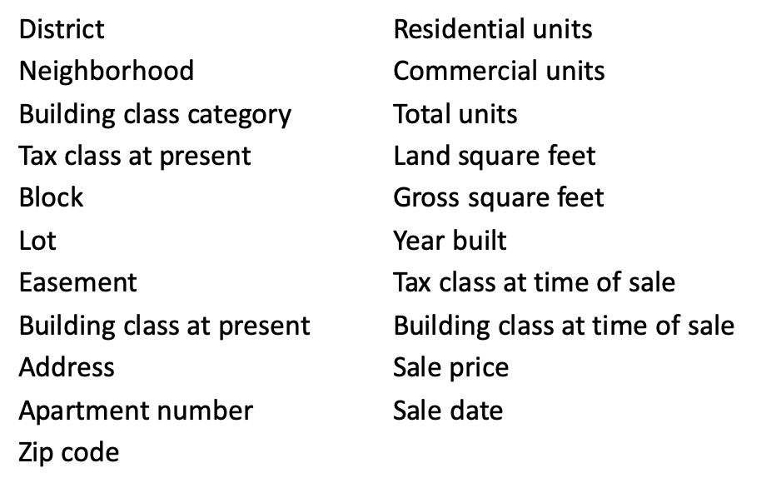
Step 1: Data collection
Number of records: 84548
Number of features: 21
https://www.kaggle.com/new-york-city/nyc-property-sales
https://www1.nyc.gov/assets/finance/downloads/pdf/07pdf/glossary_rsf071607.pdf

Slide 5
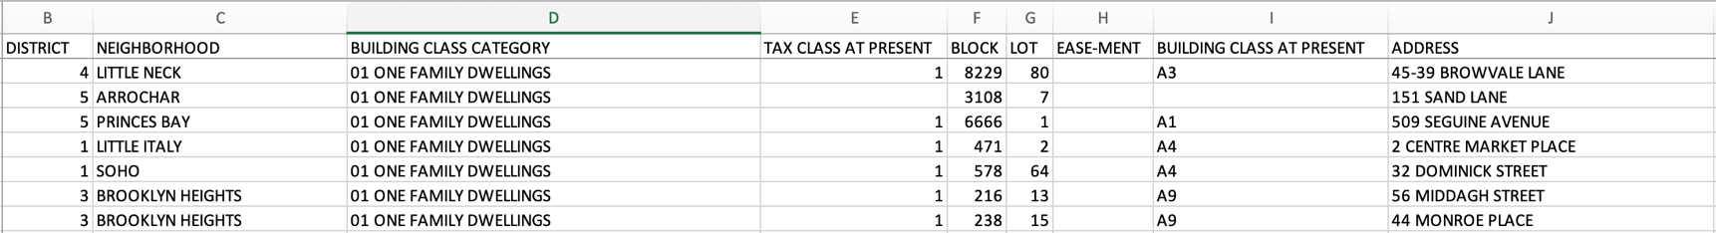
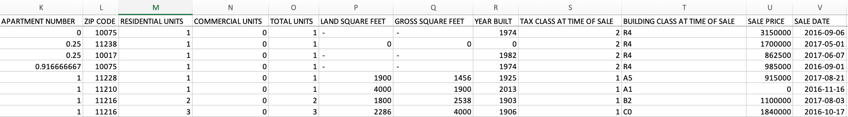
Step 2: Data exploration

Slide 6
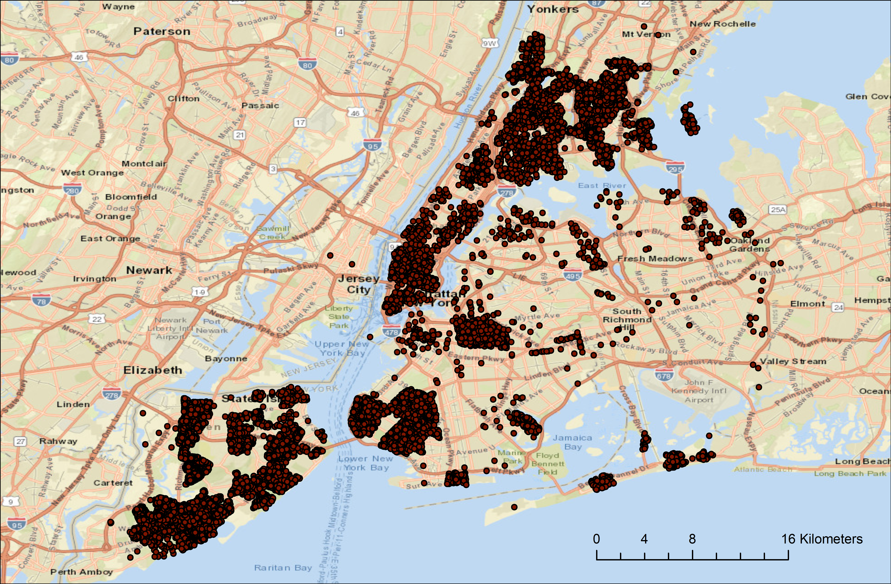
Study Area

Slide 7
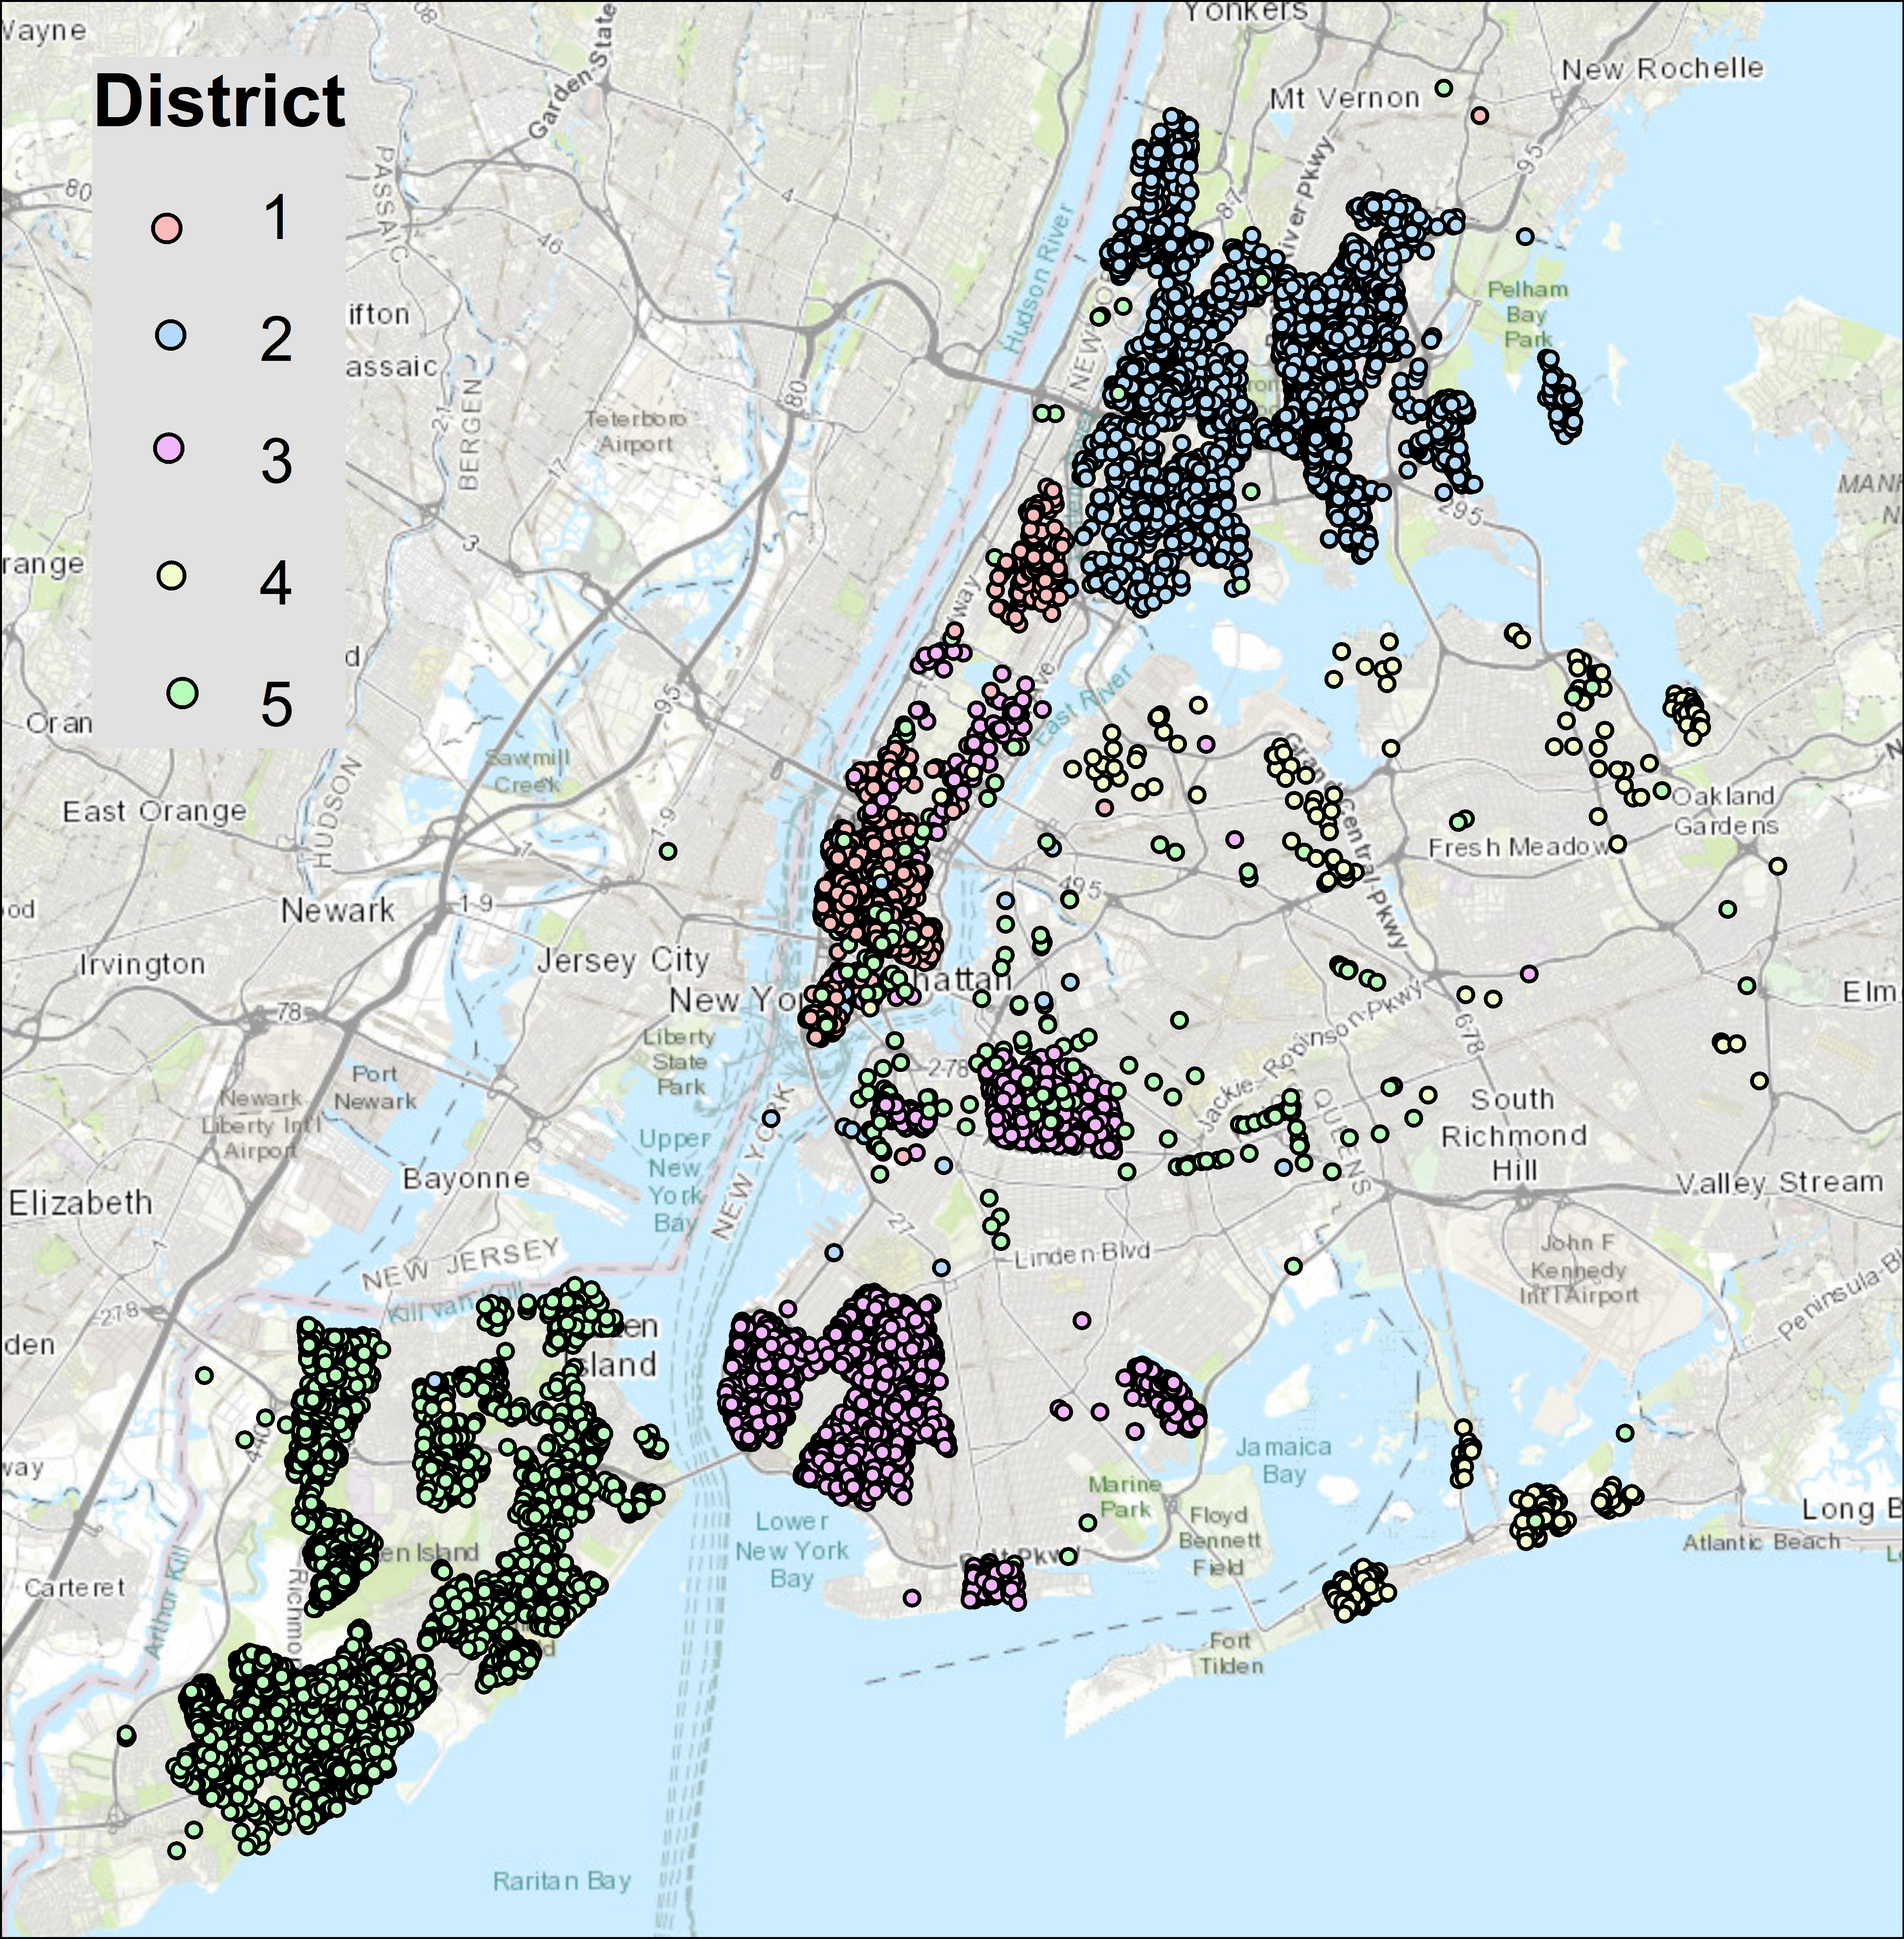
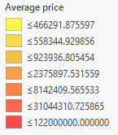
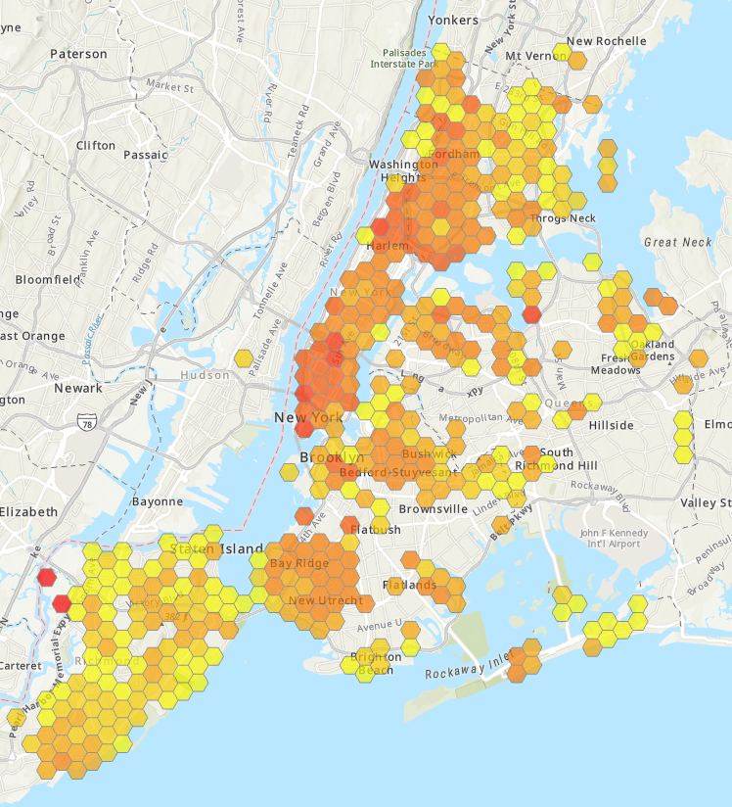
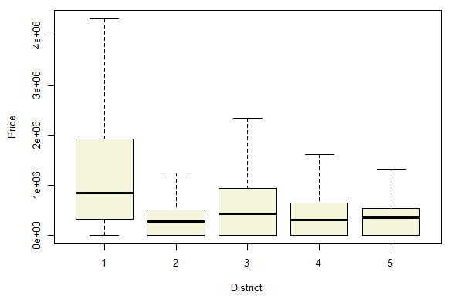

Slide 8
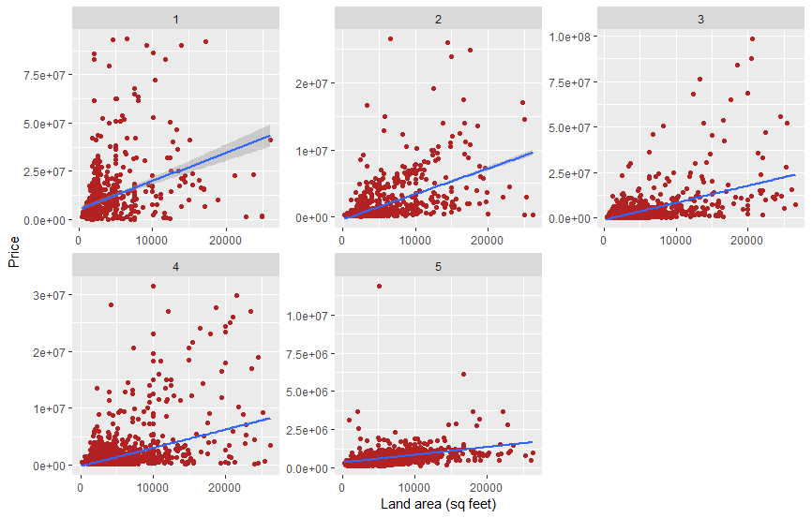
Relationship between price and land area in each district

Slide 9
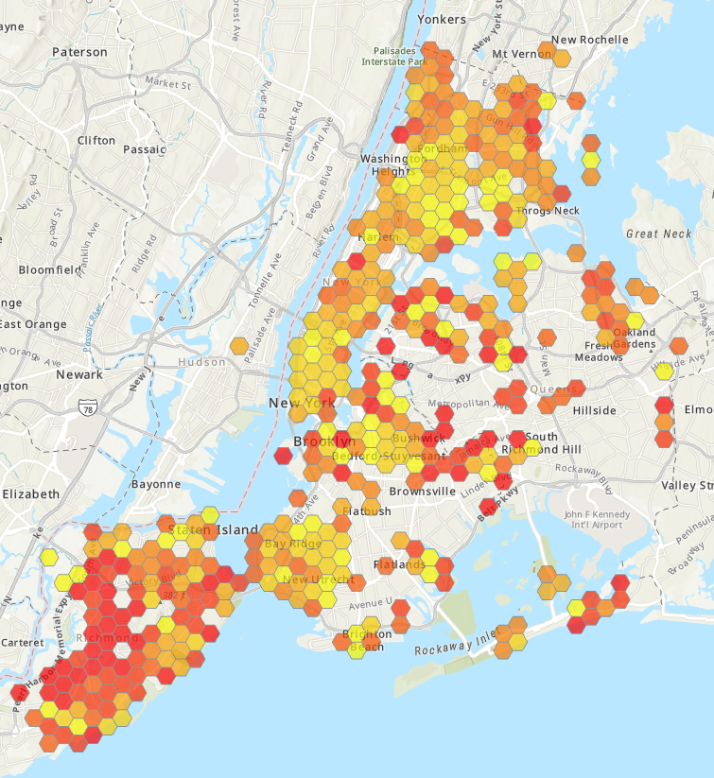
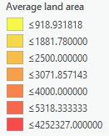
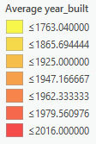
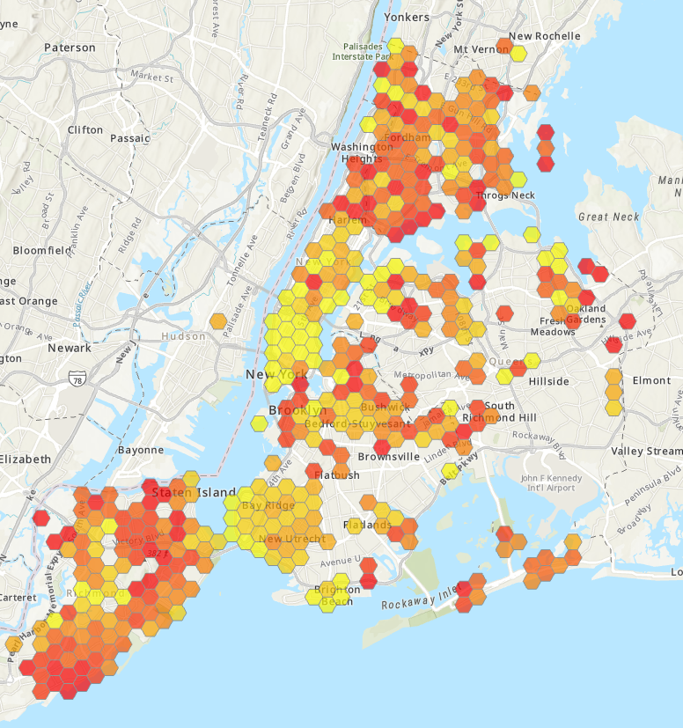

Slide 10
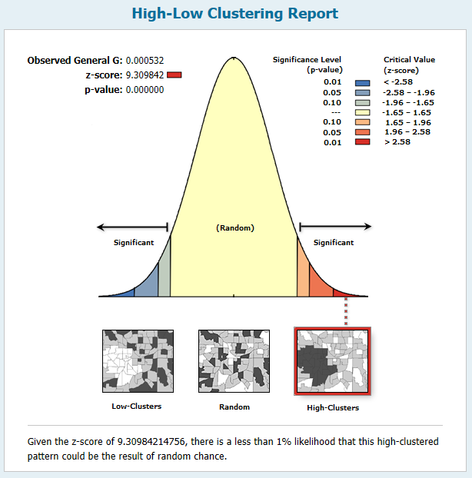
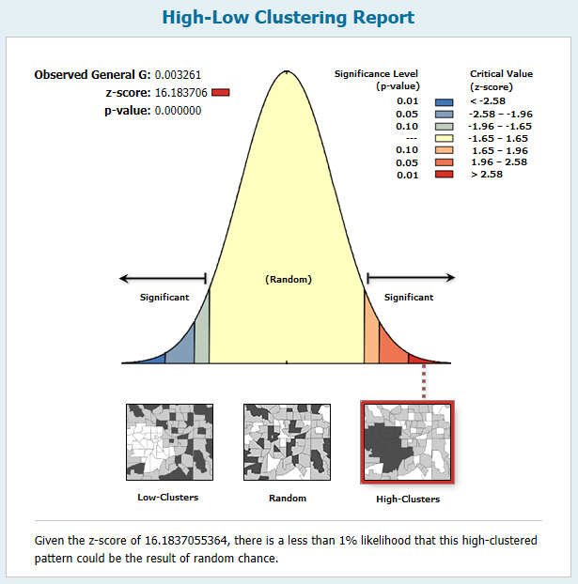
Price
Year Built

Slide 11
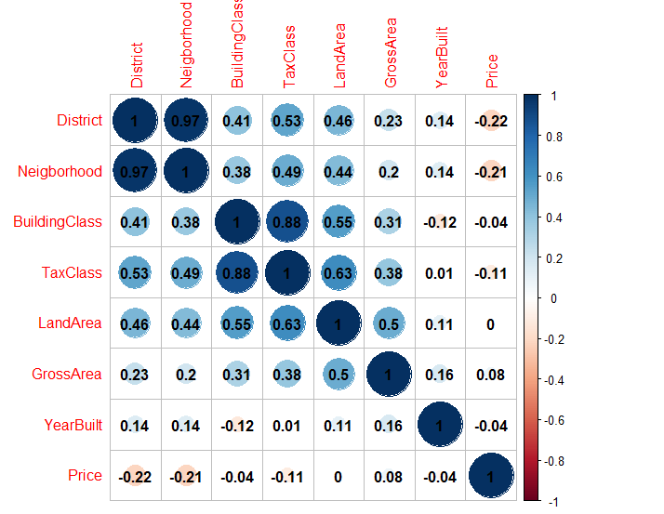
Correlation

Slide 12
Step 3: Data formatting
Normalization
Convert `-`, `null` to 0
Convert String to Numeric
Validation​
Correct or eliminate invalid values

Slide 13
Step 4: Feature Engineering
Derive new features
Derived year, month, day from date
Append external data​
Appended monthly mortgage rate​

Slide 14
Step 5: Feature Selection
district
neighborhood
block
address
apartment number
zip code
commercial units
Easement
lot
land_square
gross_square
year_built
tax_class_at_present
building_class_category
building_class_at_present
building_class_at_time_of_sale
residential_units
total_units
sale_date
sale_year
sale_month
sale_day
mortgage_rate_at_time_of_sale
mortgage_rate_at_time_of_sale_1_month_before
mortgage_rate_at_time_of_sale_2_month_before
mortgage_rate_at_time_of_sale_3_month_before

Slide 15
Step 6: Training
Scikit-learn
https://scikit-learn.org/
To generate training set (training_X, training_y) and testing set(testing_X, testing_y)​
train_X, test_X, train_y, test_y = train_test_split(X, y, test_size=0.8)

Slide 16
Step 7: Prediction
Algorithm
Linear Regression
Random Forest
To build model
model = LinearRegression() model.fit(train_X, train_y)
To generate predicted values
pred_y = model.predict(test_X)

Slide 17
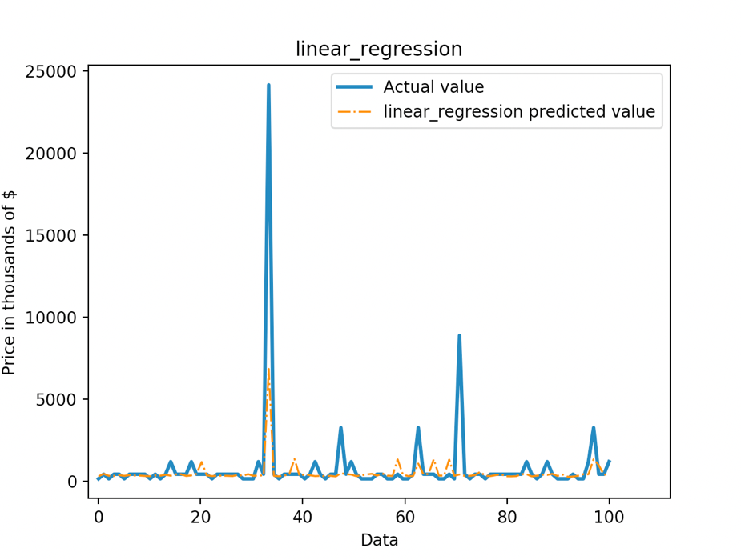
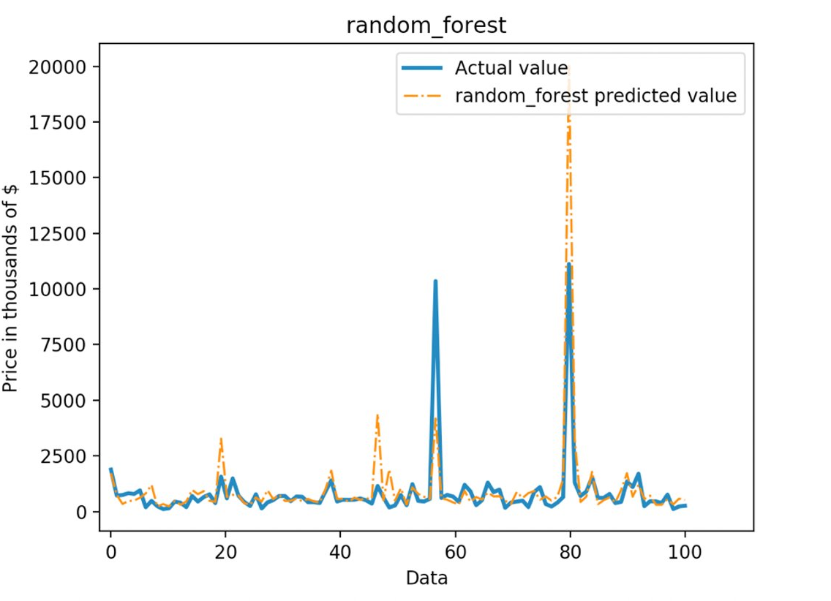
Step 8: Evaluation
Accuracy: 0.225
Accuracy: 0.541

Slide 18
Linear Regression
def __init__(self,
fit_intercept=True,
normalize=False,
copy_X=True, n_jobs=None):
Random forest
def __init__(self, n_estimators='warn', criterion="mse", max_depth=None, min_samples_split=2, min_samples_leaf=1, min_weight_fraction_leaf=0., max_features="auto", max_leaf_nodes=None, min_impurity_decrease=0., min_impurity_split=None, bootstrap=True, oob_score=False, n_jobs=None, random_state=None, verbose=0, warm_start=False):

Slide 19
Random forest feature importance
(0.4827, 'land_square'),
(0.1184, 'year_built'),
(0.0654, 'gross_square'),
(0.0531, 'sale_month'),
(0.0441, 'residential_units'),
(0.0232, 'tax_class_at_present'),
(0.0183, 'building_class_at_time_of_sale'),
(0.0162, 'building_class_at_present'),
(0.016, 'mortgage_rate_at_time_of_sale_2'),
(0.0154, 'sale_year'),
(0.015, 'sale_day'),
(0.0149, 'building_class_category'),
(0.0131, 'mortgage_rate_at_time_of_sale'),
(0.0119, 'mortgage_rate_at_time_of_sale_1'),
(0.0011, 'total_units'),
(0.0011, 'district')

Slide 20

{
'land_square': 1650,
'gross_square': 2228,
'year_built': 1881,
'district': 4,
'neighborhood': 176,
'tax_class_at_present': 6,
'building_class_category': 17,
'building_class_at_present': 2,
'building_class_at_time_of_sale': 27,
'residential_units': 2,
'commercial_units': 0,
'total_units': 12,
'sale_year': 2017,
'sale_month': 12,
'sale_day': 10,
'mortgage_rate_at_time_of_sale': 3.95,
'mortgage_rate_at_time_of_sale_1': 3.92,
'mortgage_rate_at_time_of_sale_2': 3.9,
'mortgage_rate_at_time_of_sale_3': 3.81
}
Predicted price is
$ 1,082,189

Slide 21

Q & A

